Slide 1
October 2023
Introduction to C++:
Workshop Four
Dr. Alexander Hill
a.d.hill@liverpool.ac.uk

Slide 2
Last Week
Memory addresses and pointers
Passing vectors into functions
Basic saving of text-based data
Plotting with Python

Slide 3
Aim of Workshop Four
Homework recap
Classes in C++
Monte Carlo

Slide 4
Resources
alex-hill94.github.io/#WS4
https://www.w3schools.com/cpp/cpp_classes.asp
https://library.lanl.gov/cgi-bin/getfile?00326866.pdf

Slide 5
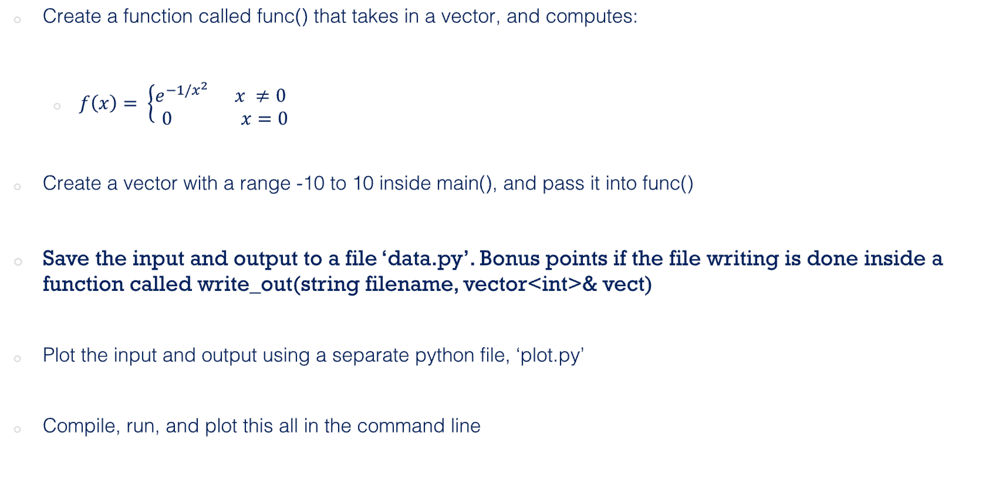
Challenge Six (Homework)
Create a function called func() that takes in a vector, and computes:
$f\left(x\right)= \left\{\begin{aligned}e^{−1/x^{2}} x ≠0 \\ 0 x=0\end{aligned} \right.$
Create a vector with a range -10 to 10 inside main(), and pass it into func()
Save the input and output to a file ‘data.py’. Bonus points if the file writing is done inside a function called write_out(string filename, vector<int>& vect)
Plot the input and output using a separate python file, ‘plot.py’
Compile, run, and plot this all in the command line

Slide 6
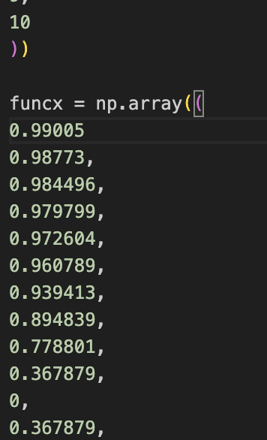
Emily
//pointer for last element of ans
double* lastElement = &ans.back();
cout << lastElement << endl;
//writing input and output to python file
ofstream myfile;
myfile.open ("data.py");
myfile << "import numpy as np" << "\n";
myfile << "x = np.array((" << "\n";
for (double j: vector){
if (j != vector.back()){
myfile << j << ", " << "\n";
}
else{
myfile << j << "\n";
}
}
myfile << "))"<< "\n" << "\n";
myfile << "funcx = np.array((" << "\n";
for (double j: ans){
if (j != ans.at(*lastElement)){ //selects last value of ans
myfile << j << ", " << "\n";
}
else{
myfile << j << "\n";}
}
File "/Users/alexhill/Documents/UOL/LIVINNO/Teaching/C++_Workshops/2023/WS4/scripts/emily/data.py", line 28
0.98773,
^
SyntaxError: invalid syntax

Slide 7
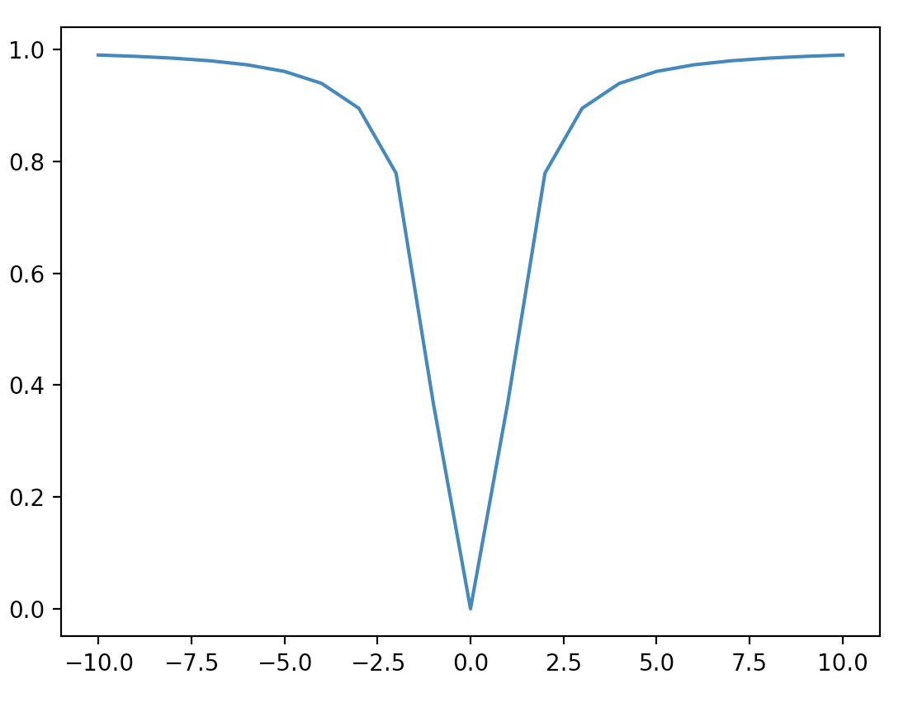
Emily
int main(){
vector<double> ans;
vector<double> vector;
for (int i = -10; i <= 10; i++) {
vector.push_back(i); //fills empty vector with values between -10 and 10
}

Slide 8
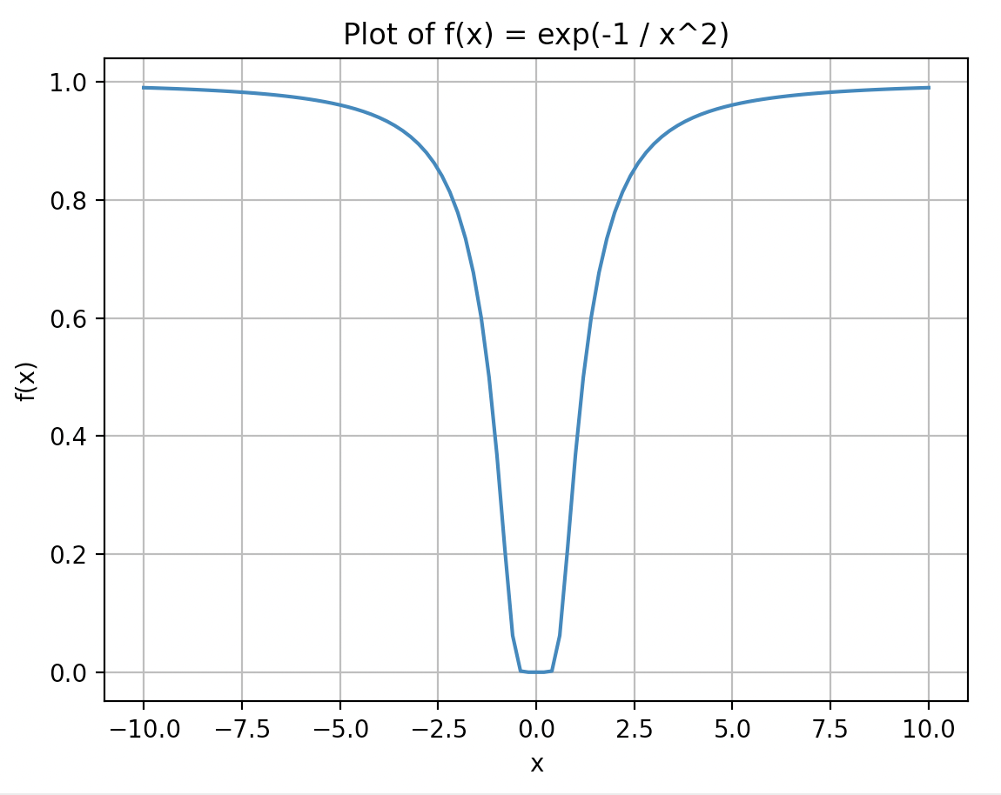
Sam
double func(double x) {
if (x == 0) return 0;
return exp(-1.0 / (x * x));
}
int main() {
vector<double> thetas;
vector<double> ans;
cout << "What would you like the length of the vector to be?\n";
int length;
cin >> length;
double stepSize = 20.0 / length;
for (double x = -10; x <= 10; x += stepSize) {
thetas.push_back(x);
ans.push_back(func(x));
}
What would you like the length of the vector to be?
100
In [2]: len(theta)
Out[2]: 101

Slide 9
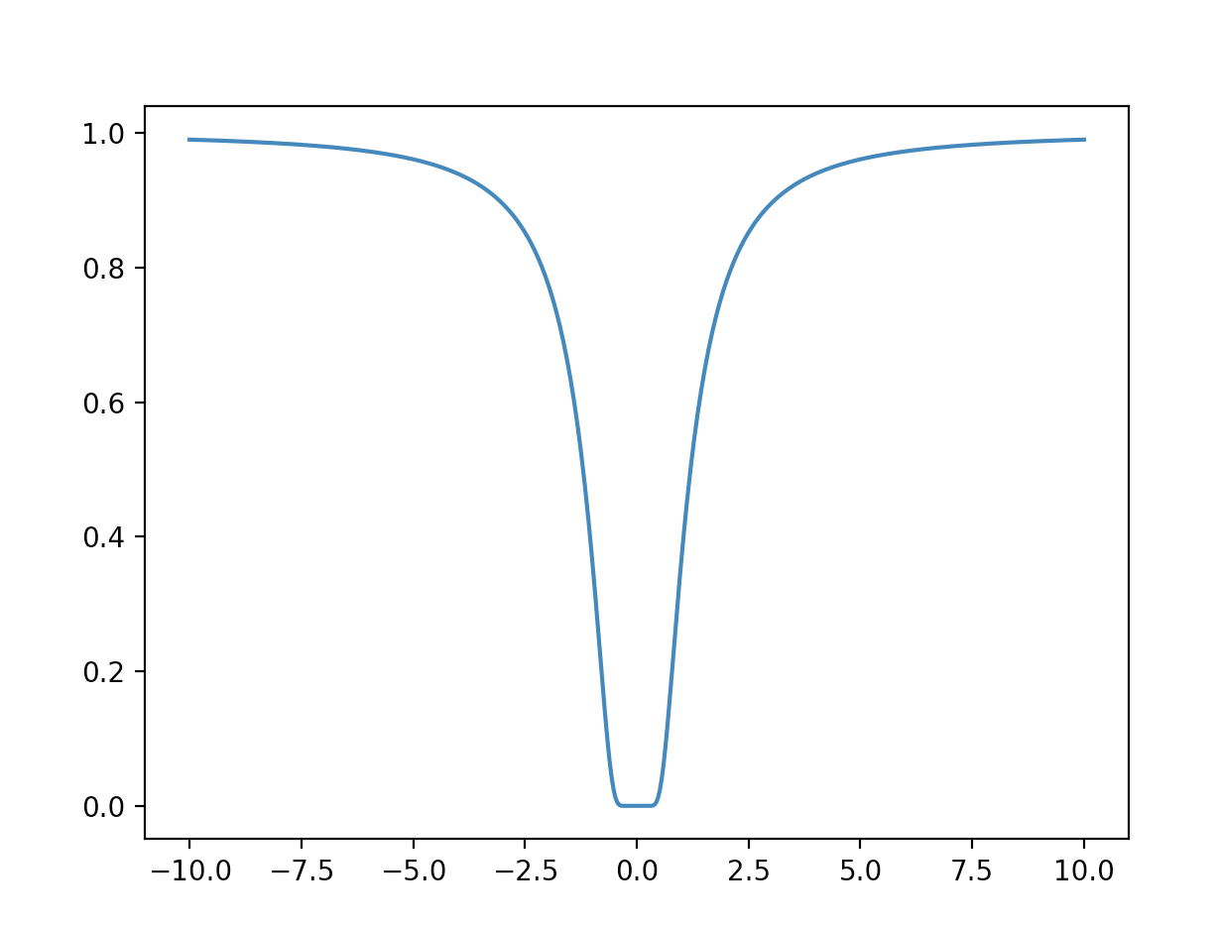
Ana
int main(){
double k=500;
//cout << "Input n_vals:";
//cin >> k;
vector<double> input;
double i = 20/k;
int b = 10;
for (double a=-10; a<=b ; a=a+i)
{
input.push_back(a);
}
vector<double> output;
func(input, output);
string myfile;
write_out("myfile", input, output);
void write_out(string outfile, vector <double>& vect, vector <double>& vectf)

Slide 10
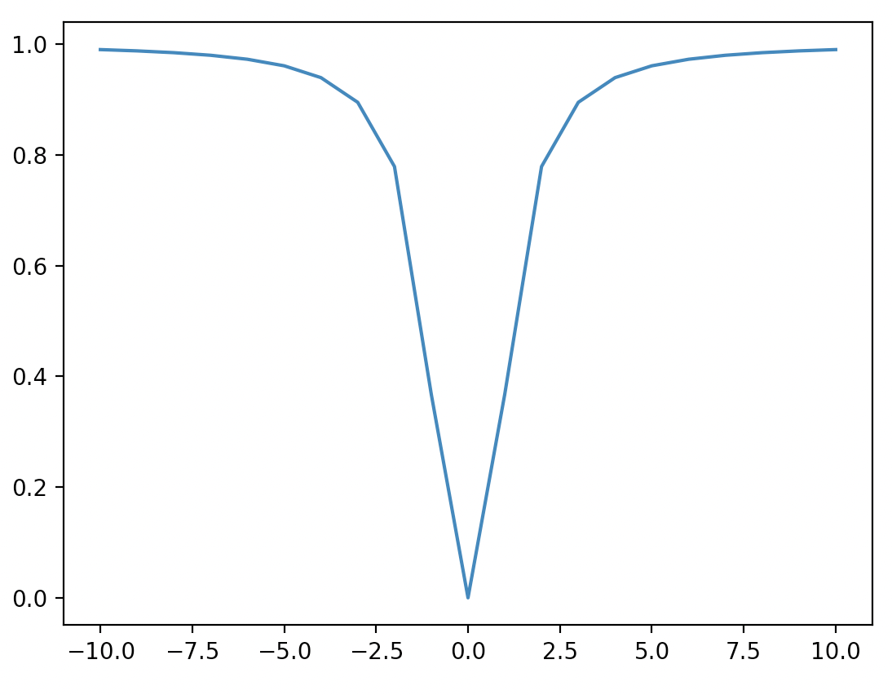
Marina
int write_out(string filename, vector<int>& x, vector<double>& f){
std::ofstream myfile;
myfile.open ("data.py");
…
…
…
cout << "Wrote to file " << filename << endl;

Slide 11
Andrew
cd "$(dirname "$0")"
output=$(g++ ./andrew.cpp 2>&1)
if [[ $? != 0 ]]; then
echo -e "Error:\n$output"
else
./a.out
python plot.py
fi
import csv
from matplotlib import pyplot as plt
x, y = [], []
with open('my_data.csv') as f:
reader = csv.reader(f, delimiter=',')
for row in reader:
x.append(row[0])
y.append(row[1])
plt.figure(figsize=(10,8))
plt.scatter(x, y)
plt.xlabel("x")
plt.ylabel("f(x)")
plt.savefig('data_plot.pdf')
plt.show()
int main()
{
vector<float> vec, result;
// generate a vector with range -10 ~ 10
for (int i = -10; i <= 10; i += 1) vec.push_back(i);
// calculate results for func()
func(vec, result);
// write results into file
wrtie_out("my_data", vec, result);
return 0;
}

Slide 12
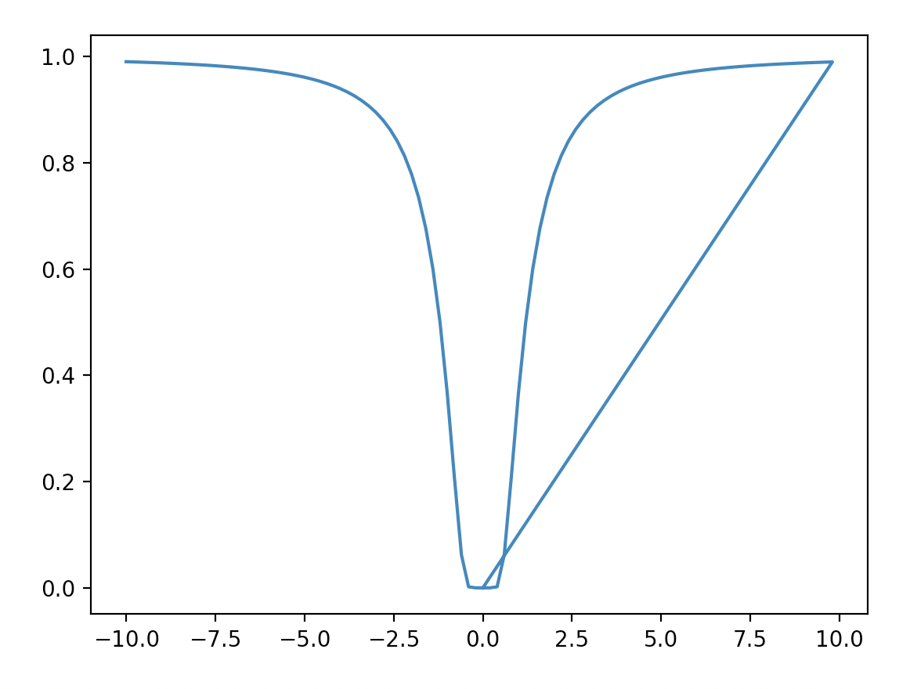
Luke
-0.2,
0
0.2,
0.4,
0.6,
…
0.0
vector<double>x(n+1); //initialise x vector
vector<double>y(n+1); //initialise y vector
for (int i=0; i<n; ++i){
x.at(i)= -10 + 20*i/n;
}
…
…
…
{if (j != x.back())
{myfile << j << ", " << "\n";}
$ ipython plot.py
File "/Users/alexhill/Documents/UOL/LIVINNO/Teaching/C++_Workshops/2023/WS4/scripts/luke/data.py", line 55
0.2,
^
SyntaxError: invalid syntax

Slide 13
Sakrican
Input Vector =
-10,
-8,
-6,
-4,
-2,
0,
2,
4,
6,
8,
10
Output =
0.99005
0.984496,
0.972604,
0.939413,
0.778801,
0,
0.778801,
0.939413,
0.972604,
0.984496,
0.99005
59 -10 0.99005
60 -10 0.99005
61 -10 0.99005
62 -10 0.99005
63 -10 0.99005
64 -10 0.99005
65 -10 0.99005
66 -10 0.99005
67 -10 0.99005
68 -10 0.99005
69 -10 0.99005
70 -10 0.99005
71 -10 0.99005
72 -10 0.99005
73 -10 0.99005
74 -10 0.99005
75 -10 0.99005
76 -10 0.99005
77 -10 0.99005
78 -10 0.99005
79 -10 0.99005
80 -10 0.99005
vector<double> vector1;
cout << "Evenly spaced vector between -10 and 10 " << endl;
for(int i=0; i < vector_size ; ++i) {
vector1.at(i) = (-10 + (i * step_size));
cout << i << " " << vector1.at(i) << endl;
}

Slide 14
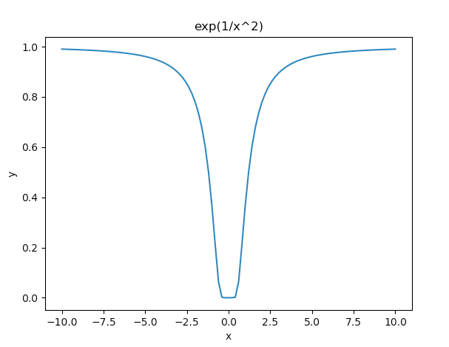

Joe
int main() {
// Create input vector with arbitrary number of points
vector<double> xValues = linspace(-10, 10, 101);
// Use function to return y values
vector<double> yValues = func(xValues);
// Write out both using write_out function
write_out("input.dat", xValues);
write_out("output.dat", yValues);
return 0;
}
// Function that returns e^(-1/x^2), or 0 if the input is 0
vector<double> func(vector<double> xValues) {
vector<double> output= {};
for (int i = 0; i < xValues.size(); i++) {
// Check whether the input is 0
if (xValues[i] == 0){
output.push_back(0);
} else{
output.push_back(exp(-1/pow(xValues[i], 2)));
}
}
return output;
}

Slide 15
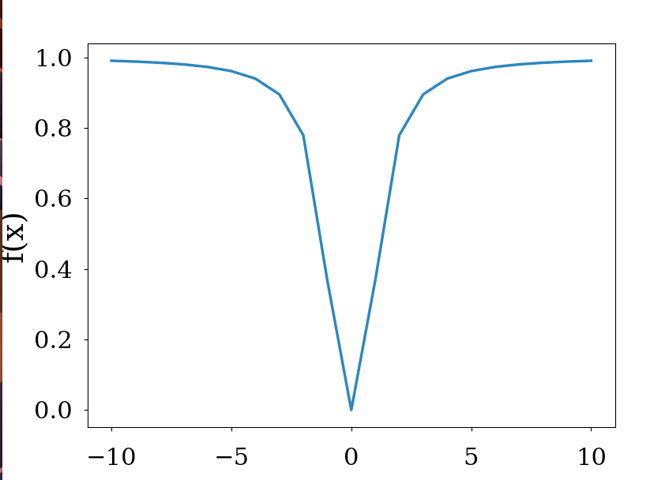
Khang
int main()
{
// vector of range -10 to 10
vector<double> vect_inp{-10,-9,-8,-7,-6,-5,-4,-3,-2,-1,0,1,2,3,4,5,6,7,8,9,10};
vector<double> vect_out;
//passing vector into function
func(vect_inp, vect_out);
// write-to-file function
write_out(vect_inp, vect_out);
return 0;
}

Slide 16
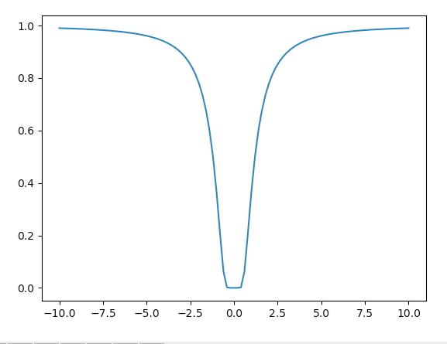
Mehul
double func(double x){
double f;
if (x == 0){ f ==0;}
else {
double poly =(1/(x*x));
f = exp(-poly);
}
return f;
}

Slide 17
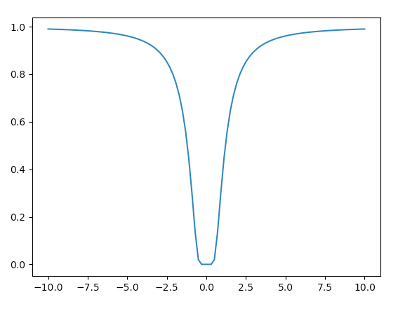
Rupesh
Ans = = np.array((
0.99005
0.989637,
0.989199,
0.988732,
0.988234,
0.987703,

Slide 18
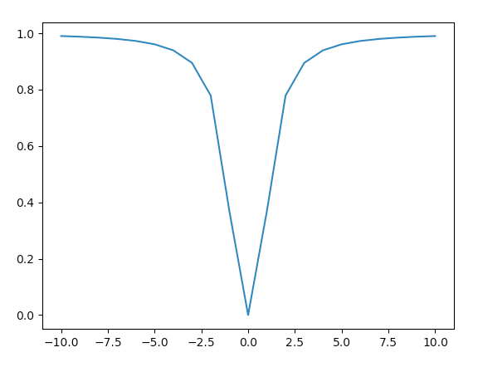
Sinead
int main() {
vector<double> v1 = {-10, -9, -8, -7, -6, -5, -4, -3, -2, -1, 0, 1, 2, 3, 4, 5, 6, 7, 8, 9, 10};
vector<double> v2(21, 0.0); // Initialize v2 with zeros and the same size as v1
for (int j = 0; j < 22; j++) {
v2[j] = func(v1[j]);
}
for (int j = 0; j < 22; j++) {
cout << v2[j] << " ";
}

Slide 19
Challenge Six Solution: Alex Modular Approach
#include <cmath>
#include <iostream>
#include <vector>
#include <fstream>
using namespace std;
void f_x(const double& x, double& fx)
{some stuff} void f_master(const vector<double>& input, vector<double>& output)
{some stuff} void write_out_vec(const string& filename, string& array_name , const vector<double>& output)
{some stuff} int main()
{some stuff}

Slide 20
Alex
void f_x(const double& x, double& fx)
{
if (x == 0)
{
fx = 0;
}
else
{
fx = exp(-1/pow(x,2));
}
}
void f_master(const vector<double>& input, vector<double>& output)
{
double temp_val;
for (auto i: input){
f_x(i, temp_val);
output.push_back(temp_val);
}
}
Fix the vector input
Create a temporary variable
temp_val is changed by f_x
Add new temp val to output vector

Slide 21
Alex
int main()
{
string filename = "data1.py";
double k;
cout << "n_vals = ?";
cin >> k;
double llim = -10;
double ulim = 10;
double seps = (ulim - llim)/(k - 1);
vector<double> x_range(k);
vector<double> fx_range;
for (int i =0; i < k; ++i)
{
x_range.at(i) = llim + (seps * i);
}
f_master(x_range, fx_range);
string x_lab = "x_range";
string fx_lab = "fx_range";
write_out_vec(filename, x_lab , x_range);
write_out_vec(filename, fx_lab , fx_range);
return 0;
}
Create input data
Compute function
Write vectors to file

Slide 22
Alex
void write_out_vec(const string& filename, string& array_name , const vector<double>& output, bool initialise = true)
// Writes out data in numpy form. If initialise == true, creates file from scratch and includes top lines needed
{
ofstream myfile;
if (initialise){
myfile.open (filename);
myfile << "import numpy as np" << "\n" << "\n";}
else{myfile.open (filename, std::ios_base::app);}
myfile << array_name << " = np.array((" << "\n";
for (auto i = 0; i < output.size(); ++i)
{if (i != (output.size() - 1))
{myfile << output.at(i) << ", " << "\n";}
else
{myfile << output.at(i) << "\n";}}
myfile << "))" << "\n"; myfile.close();}
Opens data file without wiping what’s already there
Loops over vector and writes out. If not at the end, then include comma

Slide 23
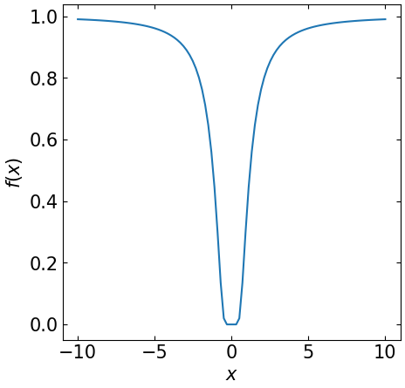
Alex
import matplotlib
import matplotlib.pyplot as plt
from data1 import *
FS = 15
matplotlib.rcParams.update({'font.size': FS})
fig, axs = plt.subplots(1,1, figsize = [5,5])
axs.plot(x_range, fx_range)
axs.set_xlabel('$x$')
axs.set_ylabel('$f(x)$')
axs.xaxis.set_tick_params(direction= 'in', which='both', right =True, top = True)
axs.yaxis.set_tick_params(direction= 'in', which='both', right =True, top = True)
plt.savefig('test.png',bbox_inches = 'tight', pad_inches = 0.05)

Slide 24
Takeaways
Use const to fix vectors when they go into functions where you are sure they shouldn’t be changed
Careful with how you identify the last element in an array

Slide 25
Takeaways
Try to make your code easily adaptable
Try editing vectors inside functions, rather than returning individual values
Fix the values of your vectors using const to ensure no mistakes
Try writing python inside a C++ script!

Slide 26
Challenge Seven
Aim: compute x^2 + 4x – 10 for an arbitrary input, save input/output data, plot the results
In main():
Create an input vector x = (start, ….., end) with len(x) = k
Set start = -100, end = 100, k = 1e6 initially
Create a blank vector called output
Pass input and output to a function func
Pass input/output to a function called write_out
In func():
Import memory addresses for input/output, i.e. don’t create copies
Fix input, allow output to change
Modify output according to x^2 + 4x – 10
In write_out():
Save data to a named python script data.py
Python script:
Load in data, plot results (you can do this inside a C++ function if you like)

Slide 27
Classes
Basics of Classes in C++
Attributes and Methods
Constructors
Access specifiers

Slide 28

Object oriented programming
Procedural programming specifies the specific steps a programme must take
OOP creates objects that contain both data and functions
Why? DRY! (Don’t repeat yourself)

Slide 29


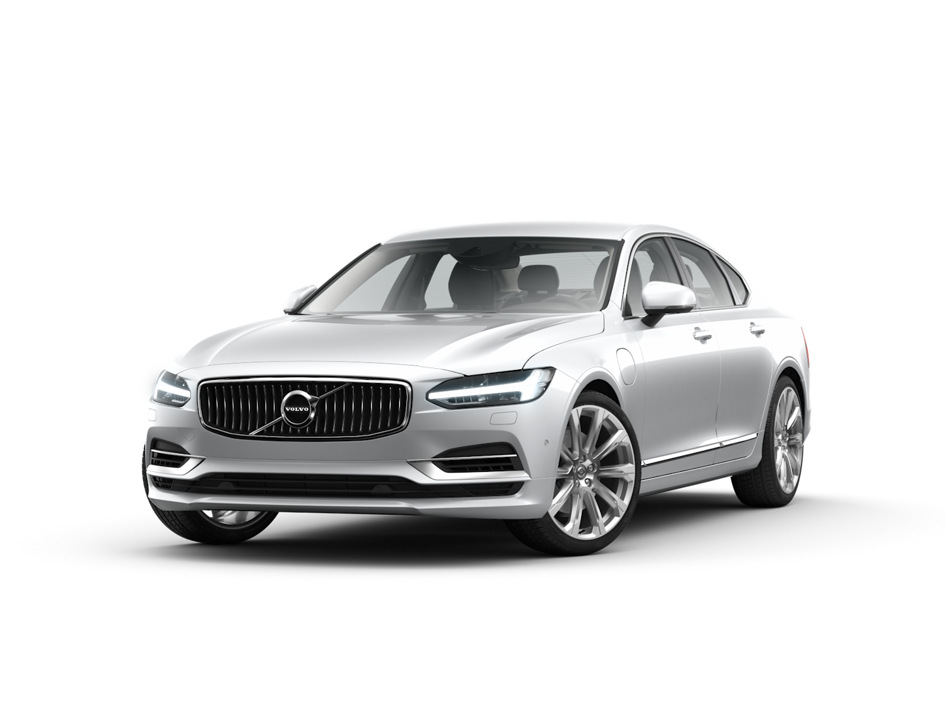

Classes and Objects
A ‘Class’ is a template for an ‘Object’
An ‘Object’ is an instance of a Class
E.g. for the ’Car’ class, you may have ‘Volvo’, ‘Audi’ and ‘Ford’ objects

Slide 30
Classes and Objects
Classes have attributes (variables, e.g. weight, colour)
Classes have methods (functions, e.g. brake, open door)
Attributes and functions are referred to as class members
Attributes
Methods

Slide 31
Classes: Attributes
Creates a class called Car
Determines how visible members of class are to the outside
#include <iostream>
using namespace std;
class Car { // The class
public: // Access specifier
int n_seats; // Attribute (int variable)
string brand; // Attribute (string variable)
string model; // Attribute (string variable)
};
int main() {
Car newcar; // Create an object of Car
// Access attributes and set values
newcar.n_seats = 5;
newcar.brand = "Seat";
newcar.model = "Ibiza";
// Print attribute values
cout << newcar.n_seats << "\n";
cout << newcar.brand << "\n";
cout << newcar.model << "\n";
return 0;
}
Creates some attributes
Creates object called newcar via the car class
Changes values of class attributes

Slide 32
Classes: Attributes
int main() {
Car peoplecarrier; // Create an object of Car
Car sportscar; // Create an object of Car
// Access attributes and set values
peoplecarrier.n_seats = 7;
sportscar.n_seats = 2;
return 0;
}
You can create multiple objects of a given class

Slide 33
Classes: Methods
Creates a function inside the class
Declare a function inside the class
#include <iostream>
using namespace std;
class Car {
public:
void Beep() {
cout << "Beep Beep" << endl;
};
int speed(int maxSpeed);
};
int Car::speed(int maxSpeed) {
return maxSpeed;
}
int main() {
Car myObj; // Create an object of Car
myObj.Beep();
cout << myObj.speed(200); // Call the method with an argument
return 0;
}
Define the function outside the class
Scope resolution operator ‘::’

Slide 34
Constructors
Constructor is called with the class name
Pass arguments to constructors when objects are created
#include <iostream>
using namespace std;
class Car { // The class
public: // Access specifier
string brand; // Attribute
Car(string x) { // Constructor with parameters
brand = x;
}
};
int main() {
// Create Car objects and call the constructor with different values
Car carObj1("BMW");
Car carObj2("Ford");
// Print values
cout << carObj1.brand << "\n";
cout << carObj2.brand << "\n";
return 0;
}
Constructors are special functions that are called whenever an object is created
You can also define constructors outside of a class

Slide 35
Access Specifier
Access specifiers can be:
Private: members cannot be viewed outside the class
Public: members are accessible outside the class
Protected: members cannot be accessed outside the class, however they can be accessed in inherited classes
By default, members are private
class Car {
public:
void Beep() {
cout << "Beep Beep" << endl;
}

Slide 36
Access Specifiers
#include <iostream>
using namespace std;
class MyClass {
public: // Public access specifier
int x; // Public attribute
private: // Private access specifier
int y; // Private attribute
};
int main() {
MyClass myObj;
myObj.x = 25; // Allowed (public)
myObj.y = 50; // Not allowed (private)
return 0;
}
$ g++ -std=c++11 -o soln lesson_ex.cpp
lesson_ex.cpp:14:9: error: 'y' is a private member of 'MyClass'
myObj.y = 50; // Not allowed (private)
^

Slide 37
Principles of OOP
Encapsulation
Inheritance
Polymorphism

Slide 38
Encapsulation
Encapsulation ensures that code and data are in a black box (if desired)
You can use the ‘private’ access specifier to ensure this
It’s often the practice to use functions to retrieve (get) and define (set) attributes
Code
Data

Slide 39
Encapsulation
#include <iostream>
using namespace std;
class Employee {
private:
int salary;
public:
void setSalary(int s) {
salary = s;
}
int getSalary() {
return salary;
}};
int main() {
Employee myObj;
myObj.setSalary(50000);
cout << myObj.getSalary();
return 0;}
(base) alexhill at Alexs-Air in ~/Documents/UOL/Teaching/C++_Workshops/Workshops/WS4/Scripts
$ ./soln
50000

Slide 40
Inheritance
You can have multilevel inheritance (Grandparent -> Parent -> Child)
#include <iostream>
using namespace std;
// Base class
class Vehicle {
public:
string brand = "Ford";
void honk() {
cout << "Toot, toot! \n" ;}};
// Derived class
class Car: public Vehicle {
public:
string model = "Mustang";};
int main() {
Car myCar;
myCar.honk();
cout << myCar.brand + " " + myCar.model;
return 0;}
Derived class inherits from parent class using ‘:’ symbol
You can also have multiple inheritance, i.e.:
class MyChildClass: public MyClass, public MyOtherClass
$ ./soln
Toot, toot!
Ford Mustang

Slide 41
Inheritance: Access Specifiers
// Base class
class Employee {
protected: // Protected access specifier
int salary;
};
// Derived class
class Programmer: public Employee {
public:
int bonus;
void setSalary(int s) {
salary = s;
}
int getSalary() {
return salary;
}
}
‘Protected’ data can be accessed by the inherited class

Slide 42
Polymorphism
Polymorphism allows us to use inherited methods to perform different tasks
#include <iostream>
using namespace std;
// Base class
class Animal {
public:
void animalSound() {
cout << "The animal makes a sound \n";
}
};
// Derived class
class Pig : public Animal {
public:
void animalSound() {
cout << "The pig says: weeee\n";
}
};
// Derived class
class Dog : public Animal {
public:
void animalSound() {
cout << "The dog says: woof \n";
}
};
int main() {
Animal myAnimal;
Pig myPig;
Dog myDog;
myAnimal.animalSound();
myPig.animalSound();
myDog.animalSound();
return 0;
}
$ ./soln
The animal makes a sound
The pig says: weee
The dog says: woof

Slide 43
Challenge Eight
Create a class called Country with attributes:
Population, size, national language
Include a method called Greet, which outputs “Hello!”
In main(), create objects from the country class called: UK, France, Spain
Use constructors to initialise the attributes mentioned above
Print all attributes and run Greet
Bonus: inside Greet include an ‘if’ statement that changes language based on the national language

Slide 44
Monte Carlo Methods
History, general concepts
Quick example
Other examples
Markov Chains

Slide 45
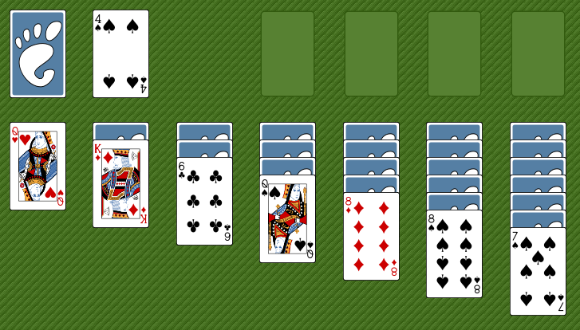
Monte Carlo History
Initially created by Stanislaw Ulam, Polish-American scientist
While ill, he wanted to know the probability of winning a game of solitaire
Finding the pure calculations too hard, he adopted a statistical approach
Playing the game would take too long, so he asked von Neumann to simulate it on an early (huge) computer

Slide 46
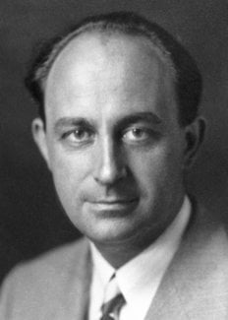
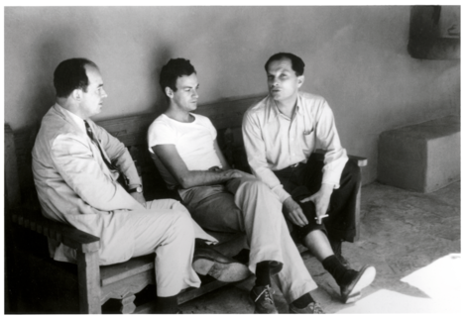
Monte Carlo History
Enrico Fermi
John von Neumann
Stanislaw Ulam
The Monte Carlo Method is a mathematical technique used to estimate the outcomes of an uncertain event
Developed during WWII in relation to the Manhattan project
Named after the Monte Carlo Casino, frequented by Ulam’s uncle, as chance is important to the modelling approach
Idea: use random sampling of inputs to explore outputs complex systems

Slide 47
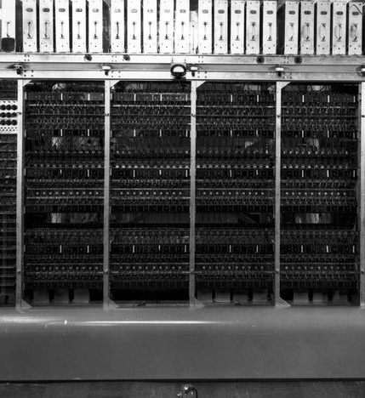

Monte Carlo History
The challenge of constructing the atom bomb involved neutron diffusion
Too challenging to be addressed analytically, needed a numerical approach
Some of the first computers tried an exhaustive numerical approach (plug in many numbers into the equation and calculate the result), but this was too slow due to high dimensionality of the problem
Monte Carlo methods were found to be remarkably successful
MANIAC Computer

Slide 48
Monte Carlo Basics
A method of estimating the value of an unknown quantity using the principles of inferential statistics
Key concepts:
Population: the universe of possible examples
Sample: a proper subset of a population
A random sample tends to exhibit the same properties as the population from which it is drawn
Use the sample to infer the statistics of the population
As the variance of the population increases, the more samples are needed to reach the same degree of confidence

Slide 49
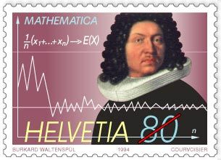
Law of Large Numbers
Law of large numbers:
In repeated independent tests with the same probability, p, of a particular outcome in each test, the chance that the fraction of times that the outcome occurs differs from p converges to zero as the number of trials goes to infinity

Slide 50
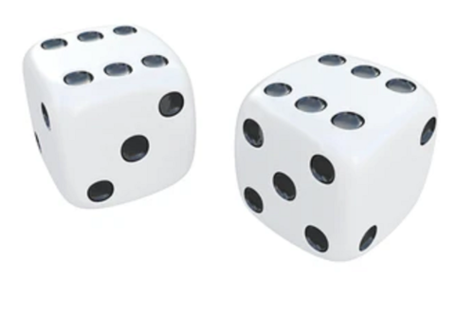
Law of large numbers
Example: roll two dice to predict probability of getting a given number in total

Slide 51
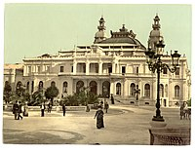
Gambler’s Fallacy
This is the idea that following a statistically unlikely set of results (e.g. many instances of red in a row in roulette), people believe that the next sample will work to bring you back to the average
Example in 1913 at Monte Carlo casino: after 15 blacks in a row, there was a rush to bet on red
After 26 reds in a row, the casino had made a fortune

Slide 52
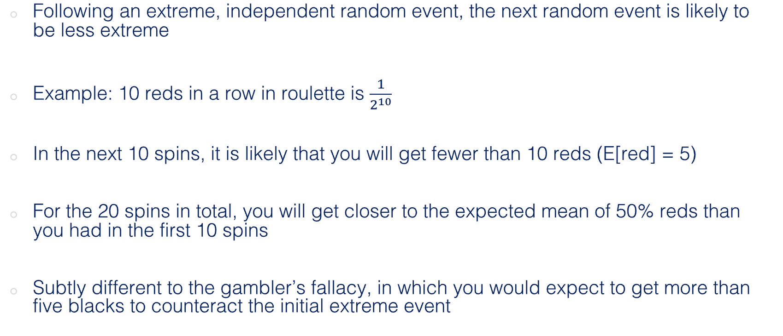
Regression to the Mean
Following an extreme, independent random event, the next random event is likely to be less extreme
Example: 10 reds in a row in roulette is $\frac{1}{2^{10}}$
In the next 10 spins, it is likely that you will get fewer than 10 reds (E[red] = 5)
For the 20 spins in total, you will get closer to the expected mean of 50% reds than you had in the first 10 spins
Subtly different to the gambler’s fallacy, in which you would expect to get more than five blacks to counteract the initial extreme event

Slide 53
Next week
Monte Carlo with Classes

